Slide 1
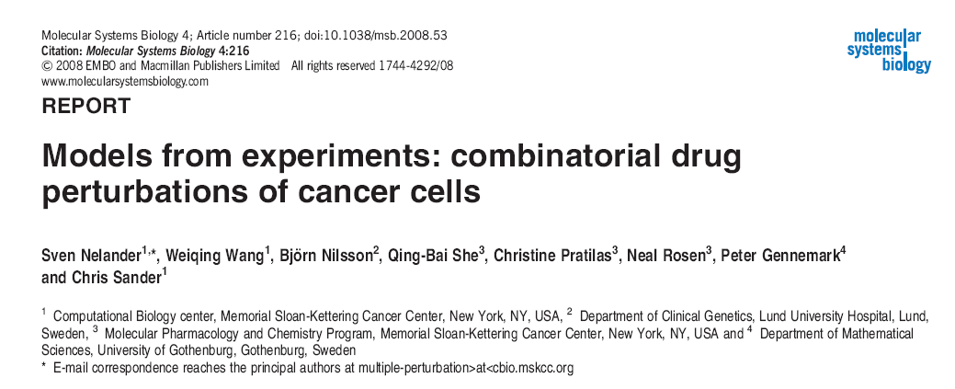
Journal club Jun17 2009, Zhen

Slide 2
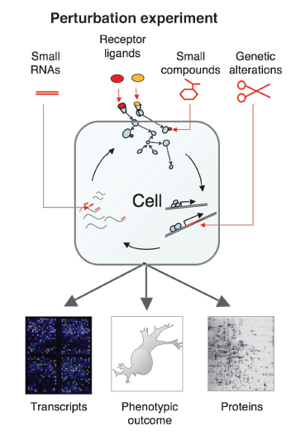
A key aim of systems biology is to relate changes in molecular behavior to phenotypic consequences.
Computational models utilize Combinatorial Perturbation result to re-construct cellular network.

Slide 3
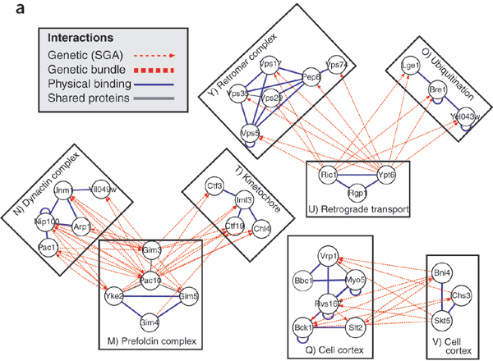
between- or within-pathway explanations, covering 40% of known genetic interactions
Kelley and Ideker, 2005
Notes:
Genetic interaction analysis,in which two mutations have a combined effect not exhibited by either mutation alone, is a powerful and widespread tool for establishing functional linkages between genes. In the yeast Saccharomyces cerevisiae, ongoing screens have generated >4,800 such genetic interaction data.

Slide 4
In many situations however, observational data are provided but the pathway is unknown or only partially known. To solve this problem, our computational modeling approach enables users to construct a complete differential equation model for a system from combinatorial perturbation experiments.
To represent such a system mathematically, we choose network models in which nodes represent molecular concentrations or levels of activity and edges reflect the influence of one node on the time derivative of another.

Slide 5
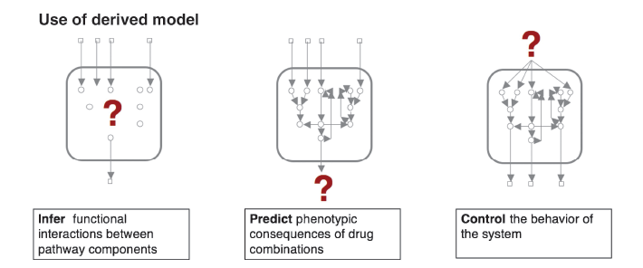

Slide 6
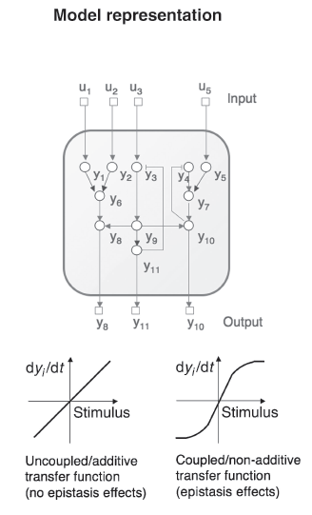
MIMO models
the vector y(t) represents state variables (the activities of the system's components),
the vector u(t) represents perturbations (external influences on the components) and
f is a linear or nonlinear transfer function

Slide 7
Nonlinear MIMO models
External impact internal change
U: perturbation
Y: states
wij>0 means 'node j activates node i', whereas wij<0 corresponds to inhibition.
Ø nonlinear transfer function

Slide 8
Infer the Wij and other parameters
First, the system of interest is subjected to a set of independent single or multiple target perturbation experiments. (drug pair perturbation in MCF7 breast cancer cell line)
parameter estimation techniques for feedback systems to find a model that minimizes a quadratic error term between observed and predicted readouts

Slide 9
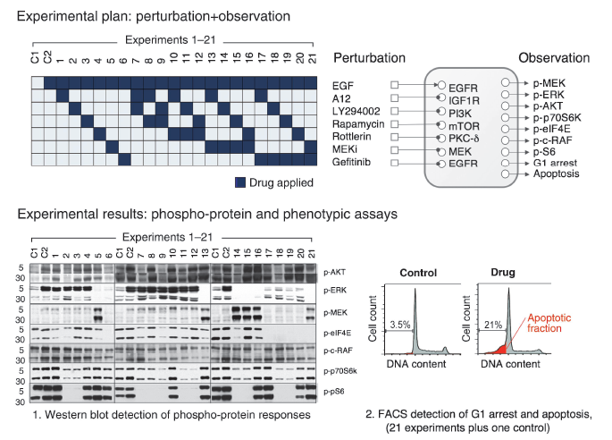
Y = 0, initially

Slide 10
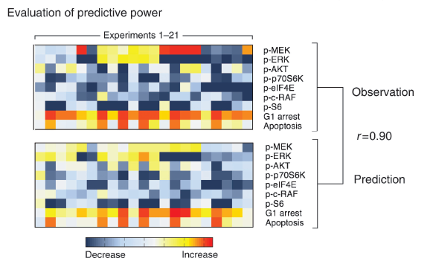

Slide 11
Outer loop{
Monte Carlo approach to search for network structure U (U1-Uk);
Iterations with probability e^{-Etotal/T} to minimize Etotal;
Inner loop{
Gradient descent algorithm
Minimization of ESSQ
To get Wij … to converge.
}
}

Slide 12
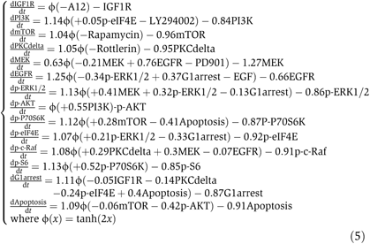
Wij here is the mean interaction next slide

Slide 13
Detection of key regulatory mechanisms
450 ‘good’ models (with smallest global error Etotal) generated.
Using bootstrap and 90% CI to assess the statistical significance of individual interaction (posterior probability %).

Slide 14
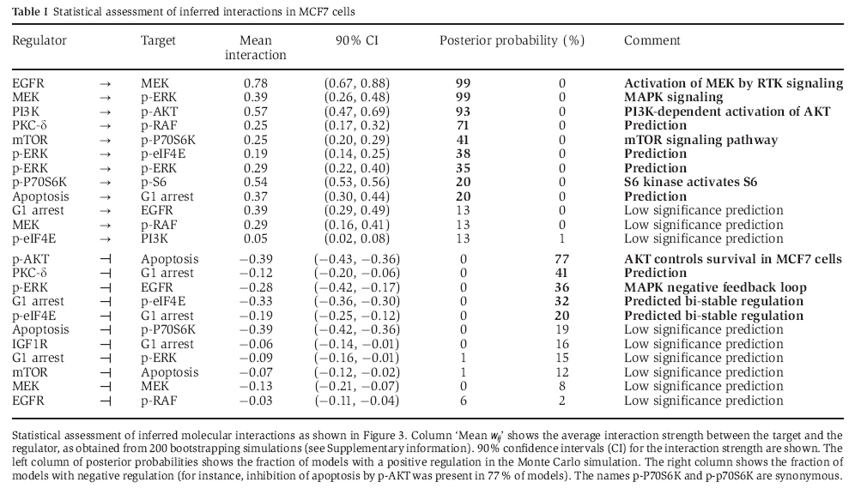

Slide 15
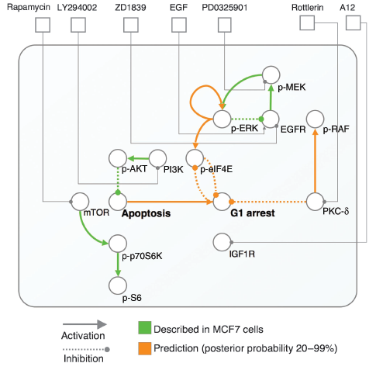

Slide 16
Conclusion
We conclude that CoPIA may be of interest as a broadly applicable tool to construct models, discover regulatory interactions and predict cellular responses. For instance, researchers can measure a set of protein phosphorylation responses to drug combinations and use the method to automatically construct network models that predict the response to novel drug combinations.

